Slide 1
Chapter No:4
Boolean Algebra and logic Simplification

Slide 2
CHAPTER OUTLINE
Boolean Operations and Expressions
Laws and Rules of Boolean Algebra
DeMorgan’s Theorems
Boolean Analysis of Logic Circuits
Logic Simplification Using Boolean Algebra
Standard Forms of Boolean Expressions
Boolean Expressions and Truth Tables
The Karnaugh Map
Karnaugh Map SOP Minimization
Karnaugh Map POS Minimization

Slide 3
LOGIC CIRCUITS OR LOGIC GATES :
The operation of different logic gates and complex circuits can be described and analyzed using Boolean Algebra
Boolean algebra:
is a mathematical tool that allows us to describe the relationship between a logic circuit’s output and its inputs as an algebraic equation (Boolean Expression).
Other techniques used in the analysis , synthesis and documentation of logic system and circuits are :
Truth table
Schematic symbol
Timing diagrams
Language

Slide 4
Boolean algebra is a mathematical tool
Truth tables are data organizational tool
Schematic symbol s are drawing tools
Timing diagrams are graphing tools
Language is universal description tool.

Slide 5
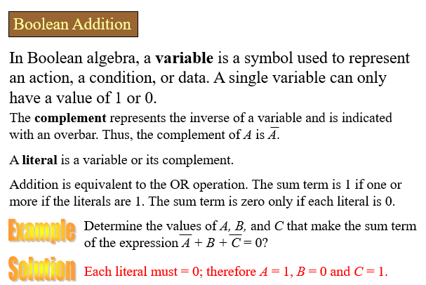
Boolean Operations and Expressions

Slide 6
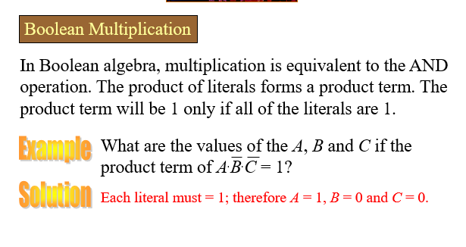

Slide 7

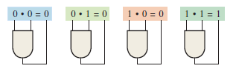
Boolean Operation and Expressions
Boolean Addition
Boolean Multiplication

Slide 8


LAWS OF BOOLEAN ALGEBRA
Commutative law :
The commutative law of addition for two variables is written as
The commutative law of multiplication for two variables is
written as

Slide 9


Associative law
The associated law of addition for three variables is written as
The associated law of multiplication for three variables is written as

Slide 10
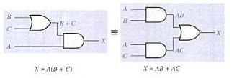
Distributive law
The distributive law is written for three variables as follows:

Slide 11
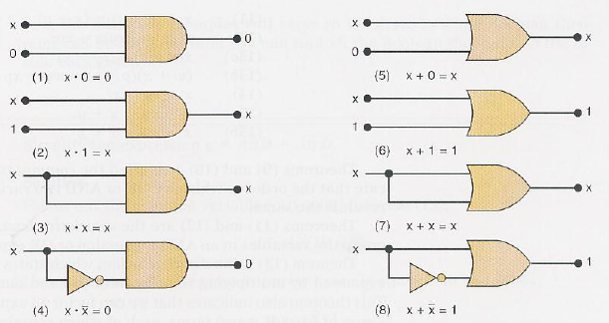
RULES OF BOOLEAN ALGEBRA
Boolean algebra can be used to help analyze a logic circuit and express its operation
Single Variable theorem :

Slide 12




MULTIVARIABLE THEOREM
It involve more than one variables.
Commutative Law:
Associative Law:
Distributive Law:
Others

Slide 13

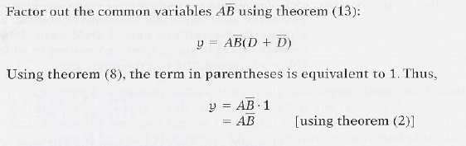
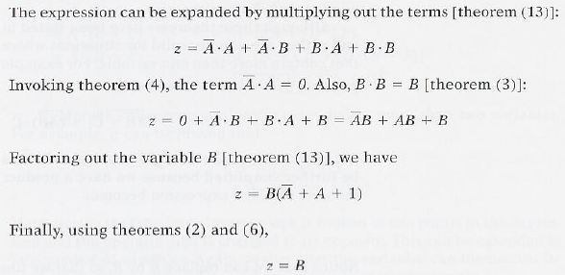
EXAMPLES:

Slide 14
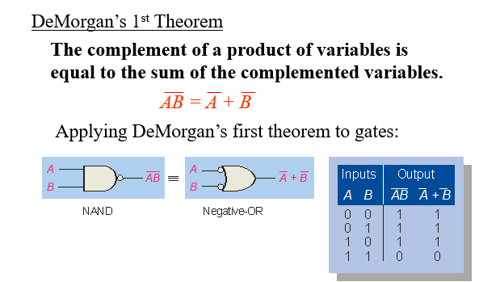
DEMORGAN ’S THEOREM
De Margan ’s theorem are extremely useful in simplifying expressions in which a product or sum of variables is inverted.

Slide 15
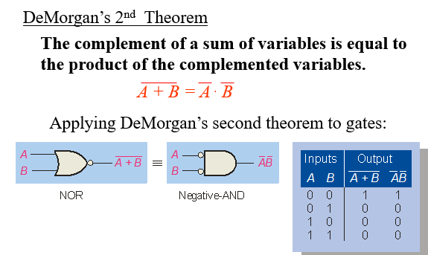

Slide 16
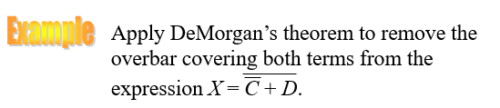
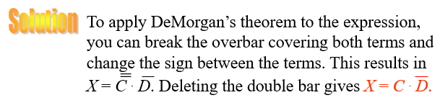

Slide 17




DEMORGAN ’S THEOREM
Apply DeMargan theorem:

Slide 18



EXAMPLE

Slide 19

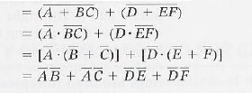


EXAMPLE

Slide 20

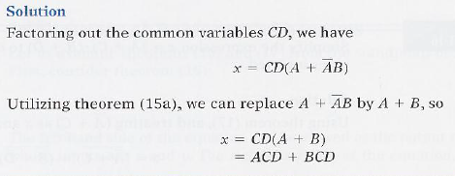




Slide 21

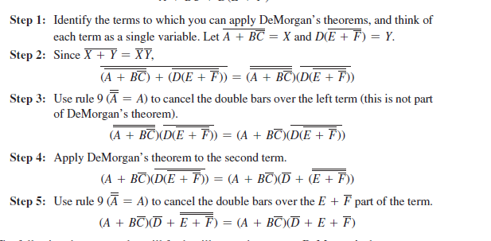

Slide 22

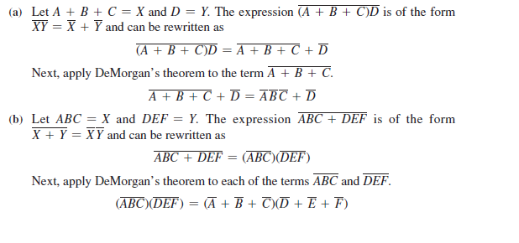

Slide 23
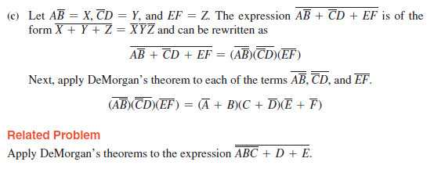

Slide 24
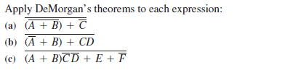
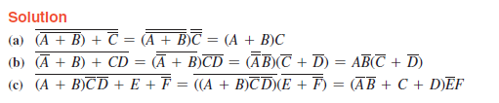

Slide 25
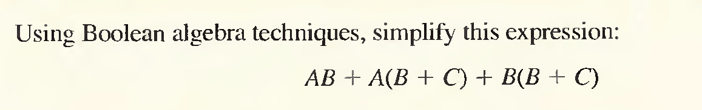
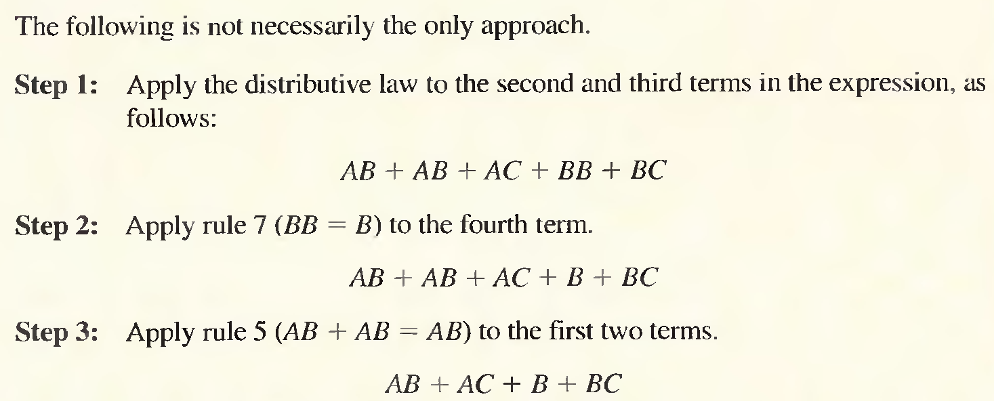

Slide 26
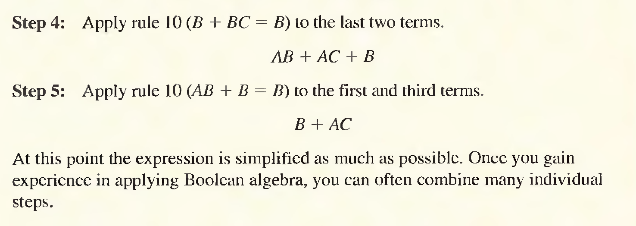

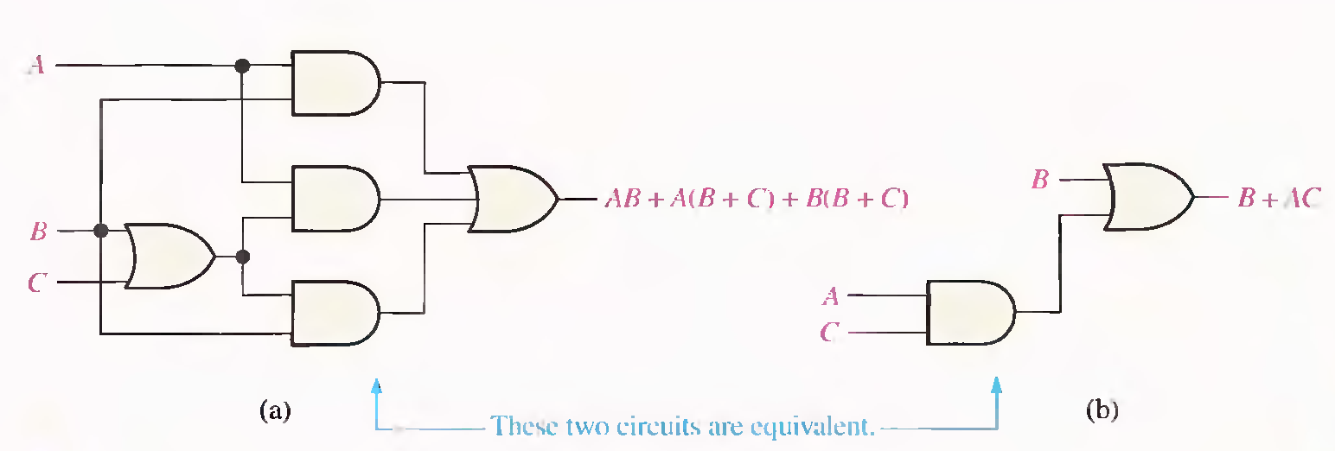

Slide 27

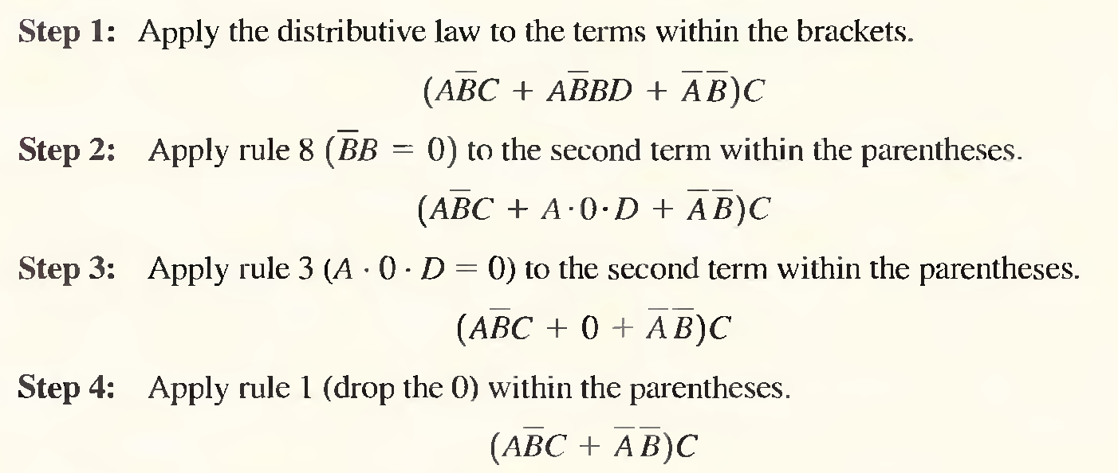
EXAMPLE

Slide 28
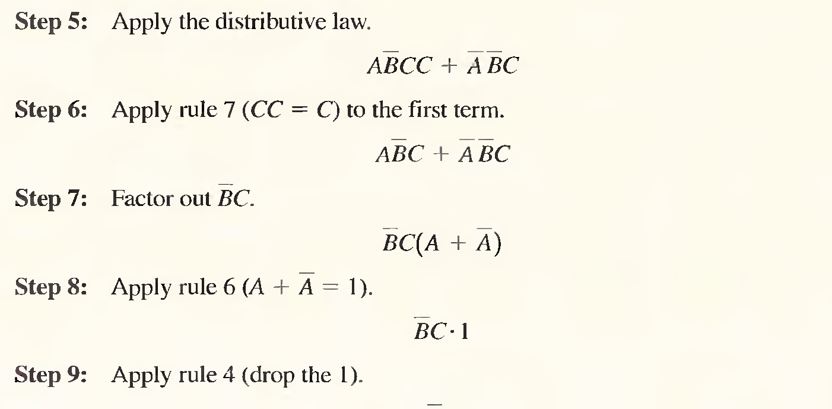
EXAMPLE

Slide 29

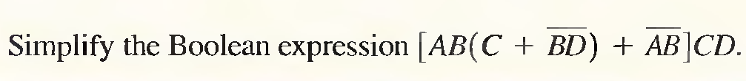

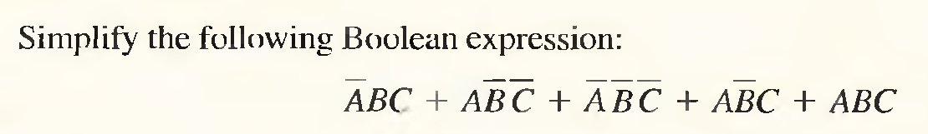

Example

Slide 30


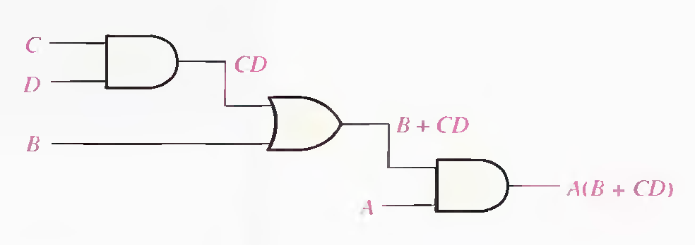
BOOLEAN ANALYSIS OF LOGIC CIRCUITS

Slide 31
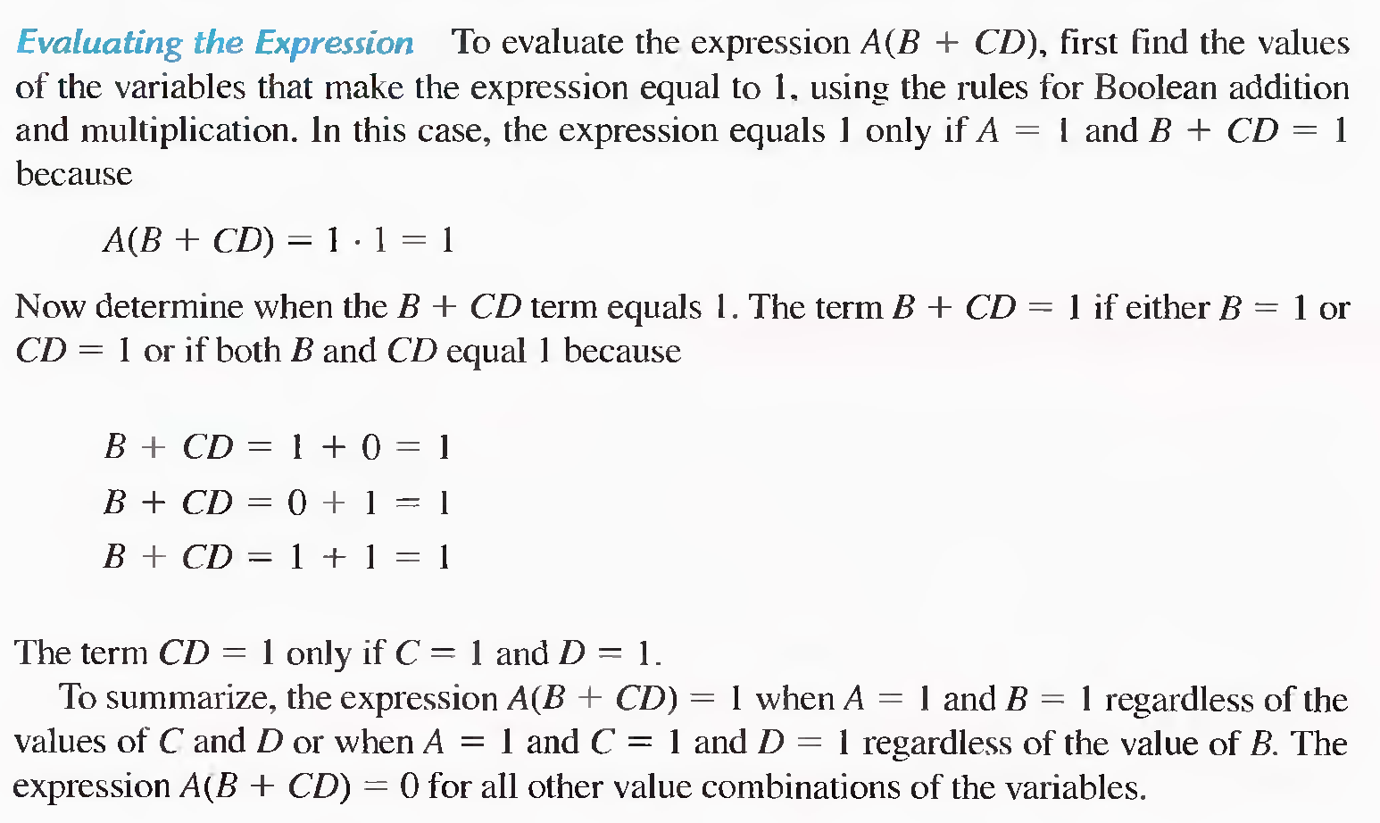
A truth table shows the output for all possible values of the
input variables can be developed. For four inputs A , B, C & D , sixteen(2^4) combination of values are possible.

Slide 32
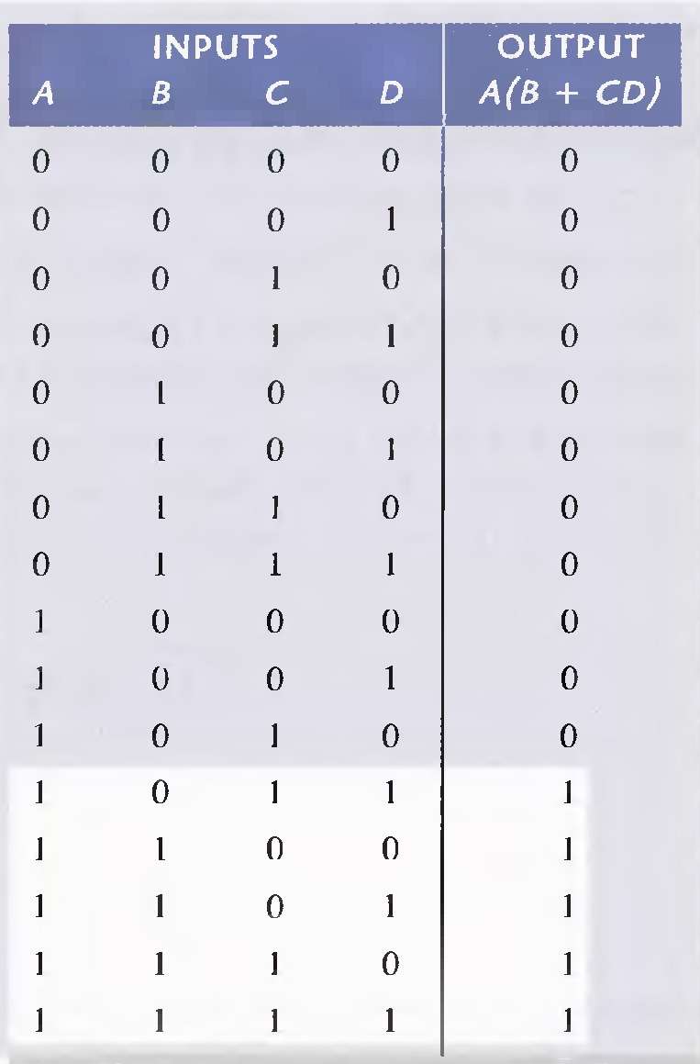
Truth Table
To summarize the expression
A (B +CD) = 1
When A=1 and B = 1 regardless of
the values of C and D
OR
When A=1 and C= 1 and D = 1
regardless of the value of B.
The expression
A (B +CD) = 0 for all other value
Combination s

Slide 33

A standard SOP expression is one in which all the variables in the domain appear in
each product term in the expression.
For example, ABCD + ABCD + ABCD
Converting Product Terms to Standard SOP Each product term in an SOP expression
that does not contain all the variables in the domain can be expanded to standard form to include all variables in the domain and their complements.
As stated in the following steps:
Step 1. Multiply each nonstandard product term by a term made up of the sum of a
missing variable and its complement (A + A’ = 1) . This results in two product terms. As you know, you can multiply anything by 1 without changing its value.
Step 2. Repeat Step 1 until all resulting product terms contain all variables in the do-
main in either complemented or uncomplemented form. In converting a product term to standard form, the number of product terms is doubled for each missing variable.

Slide 34
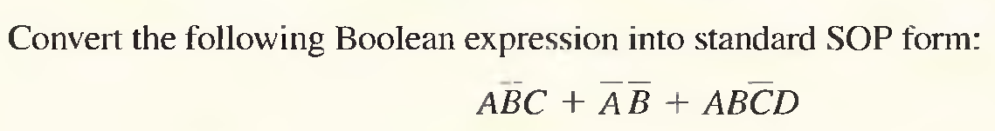
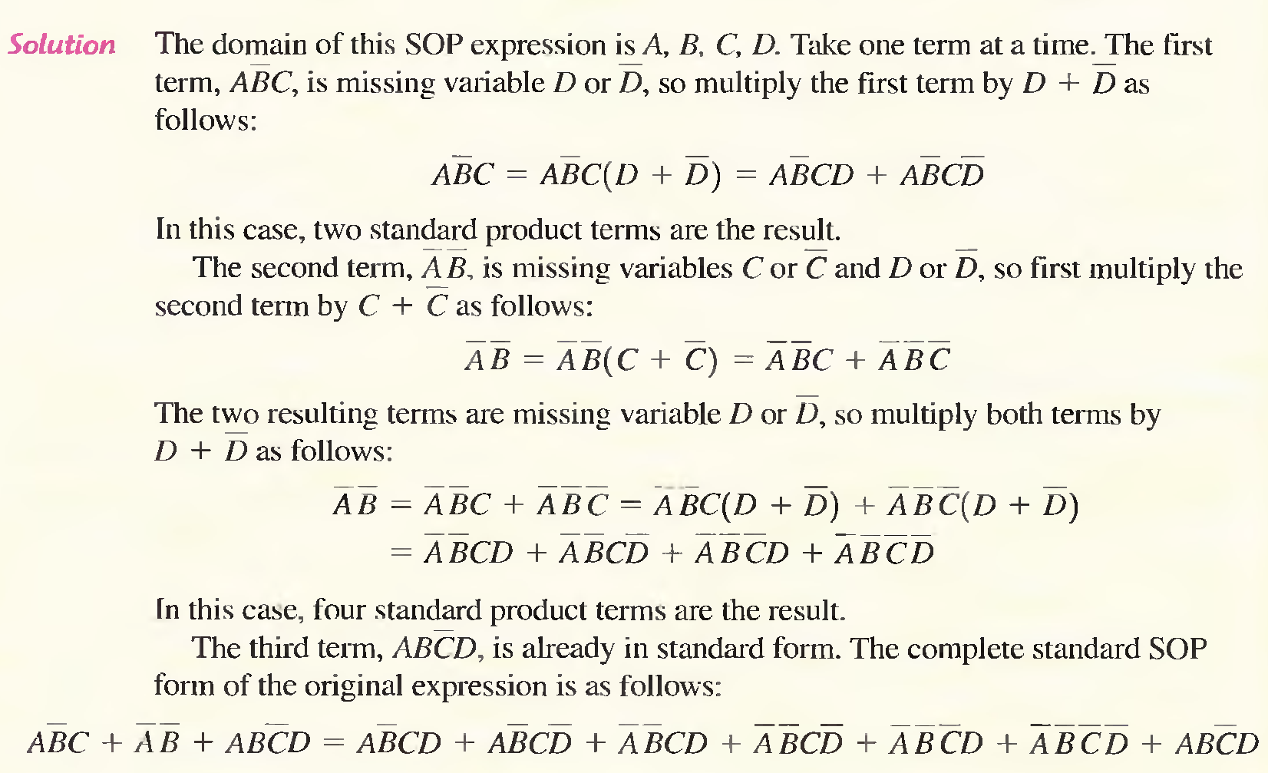

Slide 35
As stated in the following steps, a non-stanard POS expression is converted into standard form using Boolean algebra rule 8 (A . A = 0) : A variable multiplied by its complement equals O.
Step 1. Add to each nonstandard product term a term made up of the product of the missing variable and its complement. This results in two sum terms. As you know, you can add 0 to anything without changing its value.
Step 2. Apply rule 12 : A + BC = (A + B)(A + C)
Step 3. Repeat Step 1 until all resulting sum terms contain all variables in the domain in either complemented or uncomplemented form.

Slide 36
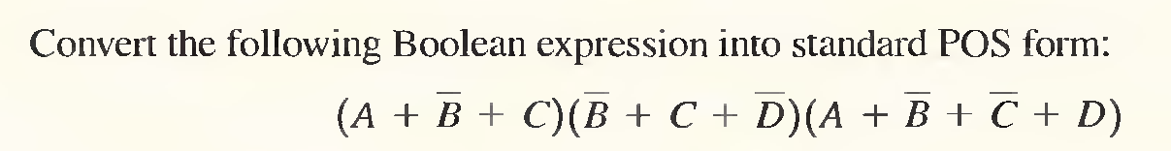
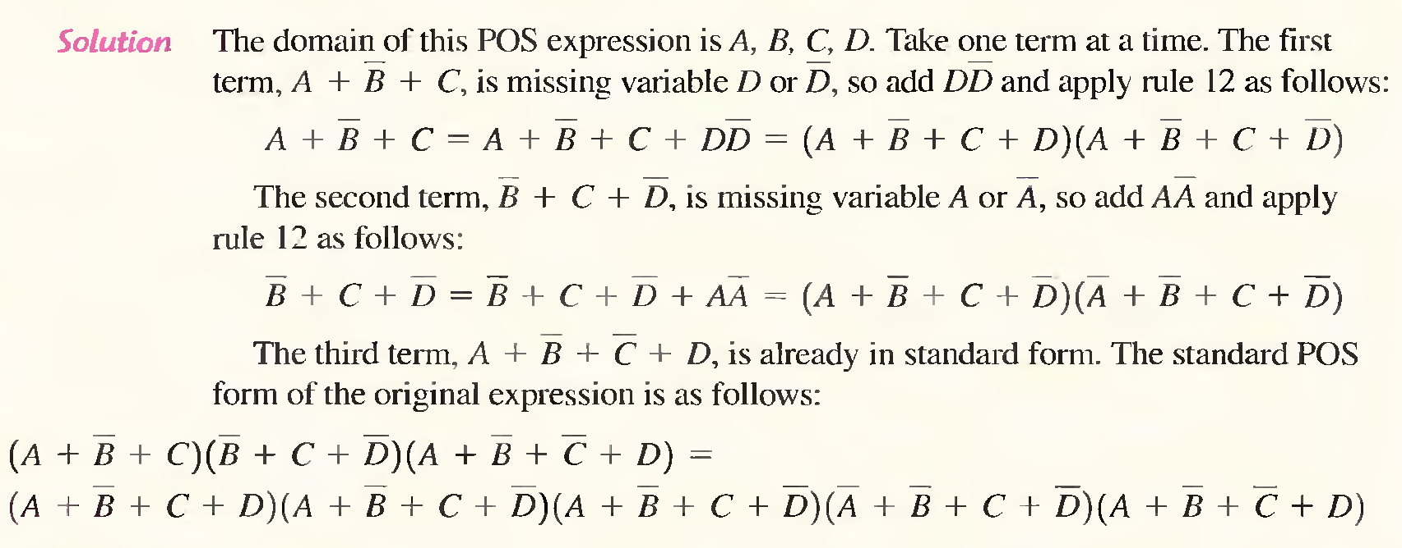

Slide 37


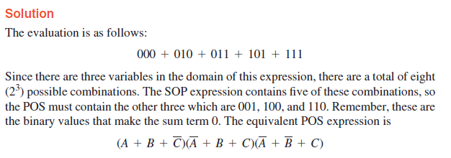
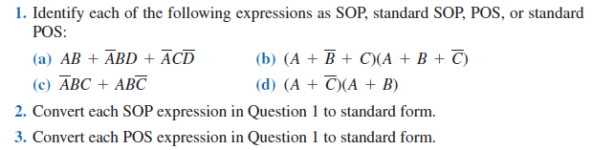

Slide 38

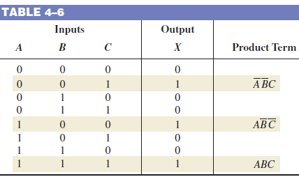
Converting SOP Expressions to Truth Table Format
Create a truth table for the standard SOP expression ABC + ABC.

Slide 39

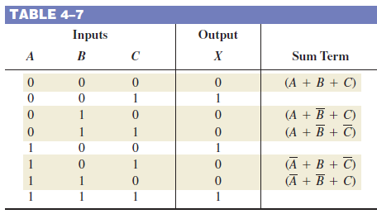

Converting POS Expressions to Truth Table Format

Slide 40
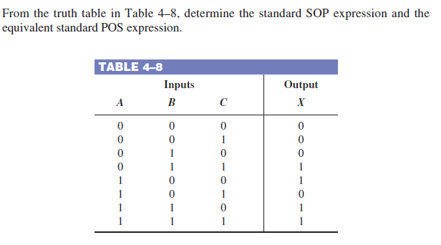

Slide 41
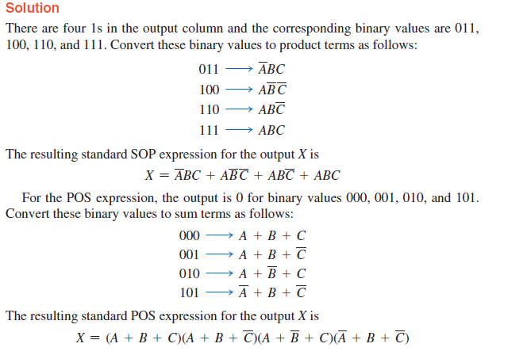

Slide 42
BINARY FUNCTION EXPRESSION
So far have seen to possible ways
  Binary equations
  Truth tables
What other ways are there?

Slide 43
STANDARD FORMS
Facilitate simplification
Result in more desirable implementations
Standard Forms rely on two type of terms
  Product Terms – Terms that are ANDed together
    XYZ
    (A+B)(C+D)(A+D)
  Sum Terms – Terms that are ORed together
    X+Y+Z
    XYZ + VX

Slide 44


Slide 45
MINTERMS
Boolean Functions can be defined by truth tables. In a Boolean function, a product term in which all the variables appear is called a minterm of the function.
Minterms specify the function as an OR of the minterms (product terms).
For 2 variables have 4 minterms
  X’Y’ X’Y XY’ XY
In general, if a function has n variables there are 2^{n} minterms
The subscript on the minterm is the decimal of the binary value represented

Slide 46
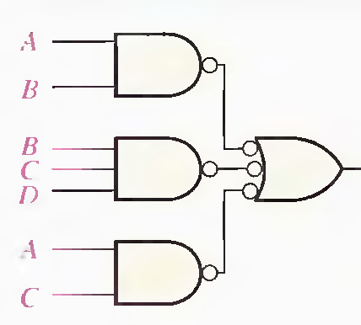
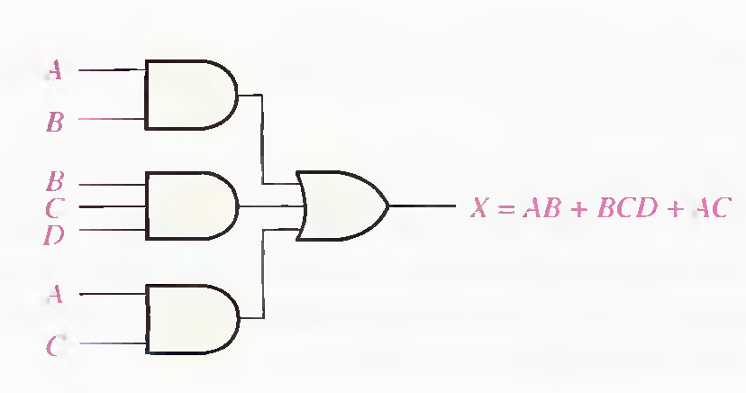
SUM-OF-PRODUCTS
Starting with the minterm specification of a function
  F(X,Y,Z) = ∑m(2,3,4,7)
  = X’YZ’ + X’YZ + XY’Z’ + XYZ
Each minterm represents a product term and then we sum them to generate the function.
This form is called sum-of-products.
Even when in minimal form it is still the sum-of-products.
  F = AB + CD + CE
  The sum-of-products form is a 2 level implementation of the function in gates

Slide 47
SOP Given a Table of Combinations
  What is the SOP form for the following 3 input / 1 output digital device?
S | A | B | f
0 | 0 | 0 | 0
0 | 0 | 1 | 0
0 | 1 | 0 | 1
0 | 1 | 1 | 1
1 | 0 | 0 | 0
1 | 0 | 1 | 1
1 | 1 | 0 | 0
1 | 1 | 1 | 1

Slide 48
Computing the SOP (2)
  This SOP has 4 minterms:
    f = S'AB' + S'AB + SA'B + SAB
S | A | B | f | minterm name
0 | 1 | 0 | 1 | m₂
0 | 1 | 1 | 1 | m₃
1 | 0 | 1 | 1 | m₅
1 | 1 | 1 | 1 | m₇

Slide 49
Canonical (Standard) SOP
  Boolean functions can use shorthand notation when in SOP form:
    f = S'AB' + S'AB + SA'B + SAB
    f(S,A,B) = Σ(m₂,m₃,m₅,m₇)
    or
    f(S,A,B) = Σm(2,3,5,7)

Slide 50
Canonical SOP Example
  f(x₁,x₂,x₃) = Σm(1,4,5,6)
  f =
minterm | x₁ | x₂ | x₃ | f
0 | 0 | 0 | 0 | 0
1 | 0 | 0 | 1 | 1
2 | 0 | 1 | 0 | 0
3 | 0 | 1 | 1 | 0
4 | 1 | 0 | 0 | 1
5 | 1 | 0 | 1 | 1
6 | 1 | 1 | 0 | 1
7 | 1 | 1 | 1 | 0
x1'x2'x3 + x1x2'x3' + x1x2'x3 + x1x2x3'

Slide 51
MAXTERMS
A sum term that contains all the variables in complemented or un-complemented form is called a maxterm.
For n variables , 2^{n} maxterms.

Slide 52
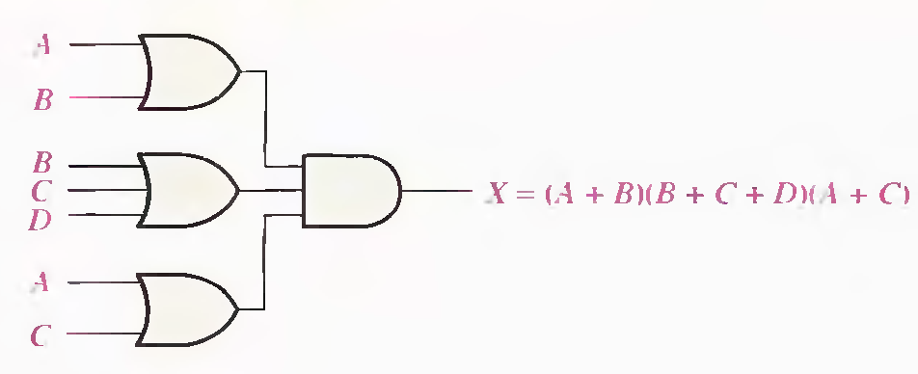
PRODUCT-OF-SUMS
This form arises from the Maxterm representation of a function.
  F(X,Y,Z) = ∏M (2,3,4,6) = (X+Y’+Z)(X+Y’+Z’)(X’+Y+Z)(X’+Y’+Z)
And now have F in a product-of-sums form
Once again, a 2 level circuit.

Slide 53
Computing the POS
  Identify rows with “0” on output (f = 0)
  Represent the input for each 0 row as a maxterm
A | B | f
0 | 0 | 0
0 | 1 | 1
1 | 0 | 0
1 | 1 | 0

Slide 54
Canonical POS Example
  f(x₁,x₂,x₃) = Π(M₀,M₂,M₃,M₇) = ΠM(0,2,3,7)
  f =
maxterm | x₁ | x₂ | x₃ | f
0 | 0 | 0 | 0 | 0
1 | 0 | 0 | 1 | 1
2 | 0 | 1 | 0 | 0
3 | 0 | 1 | 1 | 0
4 | 1 | 0 | 0 | 1
5 | 1 | 0 | 1 | 1
6 | 1 | 1 | 0 | 1
7 | 1 | 1 | 1 | 0
  (x1+x2+x3)(x1+x2'+x3)(x1+x2'+x3')(x1'+x2'+x3')

Slide 55
Example: 3 Way Light Control
  L(A,B,C) = Σm(5,6)
  or
  L(A,B,C) = ΠM(0,1,2,3,4,7)
  SOP:
    L =
  POS:
    L =
A | B | C | L
0 | 0 | 0 | 0
0 | 0 | 1 | 0
0 | 1 | 0 | 0
0 | 1 | 1 | 0
1 | 0 | 0 | 0
1 | 0 | 1 | 1
1 | 1 | 0 | 1
1 | 1 | 1 | 0
    (A B' C)+(A B C')
(A+B+C)(A+B+C') (A+B'+C)(A+B'+C‘)(A'+B+C)(A'+B'+C')

Slide 56
INTERCHANGE CANONICAL SOP AND POS
For the same Boolean eqn
  Canonical SOP form is complementary to its canonical POS form
  Use missing terms to interchange Σ and Π
Examples
  F(A,B,C) = Σ m(0,1,4,6,7)
  Can be re-expressed by
  F(A,B,C) = Π M(2,3,5)
  Where 2, 3, 5 are the missing minterms in the canonical SOP form

Slide 57
WHAT ARE KARNAUGH MAPS?
Karnaugh maps provide an alternative way of simplifying logic circuits.
Instead of using Boolean algebra simplification techniques, you can transfer logic values from a Boolean statement or a truth table into a Karnaugh map.
The arrangement of 0's and 1's within the map helps you to visualize the logic relationships between the variables and leads directly to a simplified Boolean statement.

Slide 58
KARNAUGH MAPS (K-MAPS)
An n-variable K-map has 2^{n} cells with each cell corresponding to an n-variable truth table value.
K-map cells are labeled with the corresponding truth-table row.
K-map cells are arranged such that adjacent cells correspond to truth rows that differ in only one bit position (logical adjacency).

Slide 59
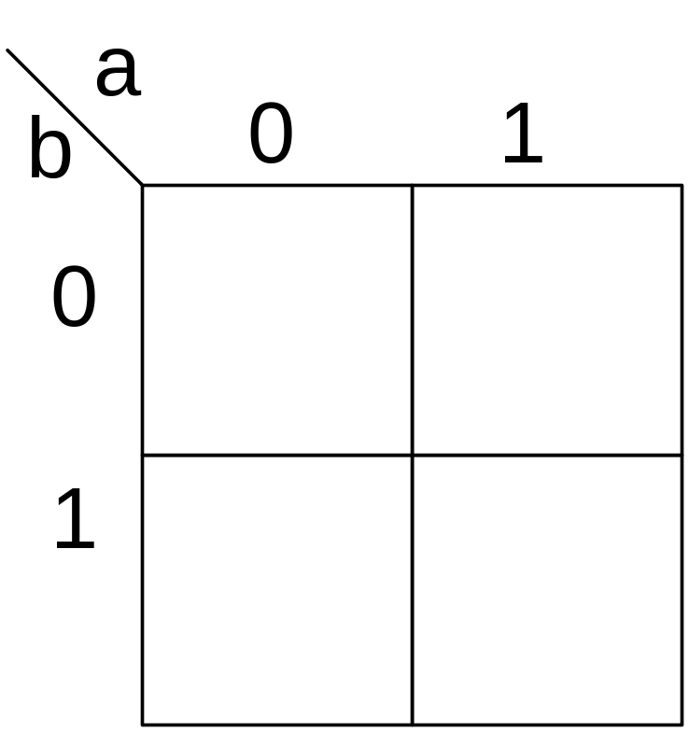
TWO-VARIABLE K-MAP

Slide 60
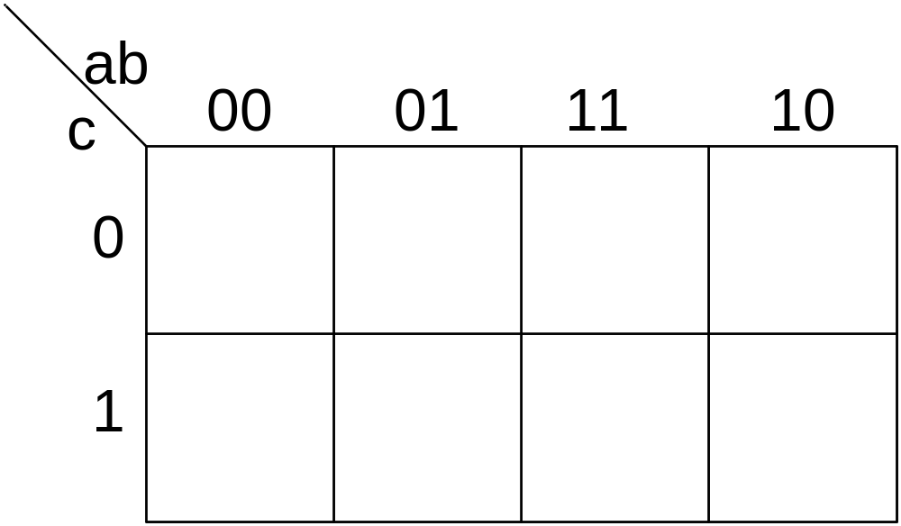

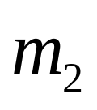
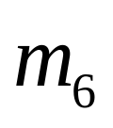
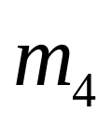
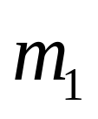
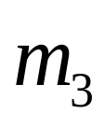
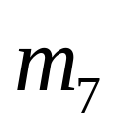

THREE-VARIABLE K-MAP

Slide 61
THREE-VARIABLE K-MAP

Slide 62
THREE-VARIABLE K-MAP
Edges are adjacent

Slide 63









FOUR-VARIABLE K-MAP

Slide 64
FOUR-VARIABLE K-MAP
Edges are adjacent
Edges are adjacent

Slide 65

FOUR-VARIABLE K-MAP

Slide 66
THREE-VARIABLE K-MAP EXAMPLE
Plot 1’s (minterms)
1
1
1
1

Slide 67
FOUR-VARIABLE K-MAP EXAMPLE
1
1
1
1
1

Slide 68
FIVE VARIABLE K-MAP
Use two four variable K-maps
A=1
A=0

Slide 69

USE TWO FOUR-VARIABLE K-MAPS
A=0 map
A=1 map

Slide 70
USE TWO FOUR-VARIABLE K-MAPS
A=0 map
A=1 map
1
1
1
1
1
1
1
1

Slide 71

FOUR VARIABLE EXAMPLE
(A) MINTERM FORM. (B) MAXTERM FORM.
f(a,b,Q,G) = ∑m(0,3,5,7,10,11,12,13,14,15) = ∏M(1,2,4,6,8,9)

Slide 72








ADJACENT CELLS = SIMPLIFICATION
 |  | V
 |  | V
 | 1 | 0
 | 1 | 0
 |  | V
 | 1 | 0
 | 1 | 0
Notes:
Adjacent cells only vary by one variable change. Review the proof that the one variable changing results in it being eliminated algebraically. This is fundamental to how a K-Map works.
Karnaugh Mapping
Digital Electronics™
2.2 Intro to NAND & NOR Logic
Project Lead The Way, Inc.
Copyright 2009

Slide 73
TRUTH TABLE TO K-MAP MAPPING
Two Variable K-Map
 |  | V
 |  | V
 | 0 | 1
 | 2 | 3
 | W | X | F_{WX}
Minterm – 0 | 0 | 0 | 1
Minterm – 1 | 0 | 1 | 0
Minterm – 2 | 1 | 0 | 1
Minterm – 3 | 1 | 1 | 0
1
0
1
0
Notes:
Demonstrate how the minterms of a two variable truth table are mapped to a K-Map.
Karnaugh Mapping
Digital Electronics™
2.2 Intro to NAND & NOR Logic
Project Lead The Way, Inc.
Copyright 2009

Slide 74








TWO VARIABLE K-MAP GROUPINGS
Groups of One – 4
 |  | V
 | 0 | 0
 | 0 | 0
1
1
1
1
Notes:
Two variable K-Map, groups of one.
Karnaugh Mapping
Digital Electronics™
2.2 Intro to NAND & NOR Logic
Project Lead The Way, Inc.
Copyright 2009

Slide 75





TWO VARIABLE K-MAP GROUPINGS
Groups of Two – 4
 |  | V
 | 0 | 0
 | 0 | 0
1
1
1
1
1
1
1
1
Notes:
Two variable K-Map, groups of two.
Karnaugh Mapping
Digital Electronics™
2.2 Intro to NAND & NOR Logic
Project Lead The Way, Inc.
Copyright 2009

Slide 76
TWO VARIABLE K-MAP GROUPINGS
Group of Four – 1
 |  | V
 | 1 | 1
 | 1 | 1
Notes:
Two variable K-Map, group of four.
Karnaugh Mapping
Digital Electronics™
2.2 Intro to NAND & NOR Logic
Project Lead The Way, Inc.
Copyright 2009

Slide 77
K-MAP SIMPLIFICATION PROCESS
Construct a label for the K-Map. Place 1s in cells corresponding to the 1s in the truth table. Place 0s in the other cells.
Identify and group all isolated 1’s. Isolated 1’s are ones that cannot be grouped with any other one, or can only be grouped with one other adjacent one.
Group any hex.
Group any octet, even if it contains some 1s already grouped but not enclosed in a hex.
Group any quad, even if it contains some 1s already grouped but not enclosed in a hex or octet.
Group any pair, even if it contains some 1s already grouped but not enclosed in a hex, octet, or quad.
OR together all terms to generate the SOP equation.
Notes:
Steps for simplifying using the K-Map process.
Karnaugh Mapping
Digital Electronics™
2.2 Intro to NAND & NOR Logic
Project Lead The Way, Inc.
Copyright 2009

Slide 78
EXAMPLE :VARIABLE K-MAP
Example:
  After labeling and transferring the truth table data into the K-Map, write the simplified sum-of-products (SOP) logic expression for the logic function F₁.
 |  | V
J | K | F₁
0 | 0 | 1
0 | 1 | 1
1 | 0 | 0
1 | 1 | 0
Notes:
Pause the presentation and allow the student to complete the example. The solution is on the next slide.
Karnaugh Mapping
Digital Electronics™
2.2 Intro to NAND & NOR Logic
Project Lead The Way, Inc.
Copyright 2009

Slide 79






EXAMPLE: VARIABLE K-MAP
Example:
  After labeling and transferring the truth table data into the K-Map, write the simplified sum-of-products (SOP) logic expression for the logic function F₁.
Solution:
 |  | V
 | 1 | 1
 | 0 | 0
J | K | F₁
0 | 0 | 1
0 | 1 | 1
1 | 0 | 0
1 | 1 | 0
Notes:
Here is the solution. If you print handouts, do not print this page.
Karnaugh Mapping
Digital Electronics™
2.2 Intro to NAND & NOR Logic
Project Lead The Way, Inc.
Copyright 2009

Slide 80






TRUTH TABLE TO K-MAP MAPPING
Three Variable K-Map
 | W | X | Y | F_{WXY}
Minterm – 0 | 0 | 0 | 0 | 1
Minterm – 1 | 0 | 0 | 1 | 0
Minterm – 2 | 0 | 1 | 0 | 0
Minterm – 3 | 0 | 1 | 1 | 0
Minterm – 4 | 1 | 0 | 0 | 0
Minterm – 5 | 1 | 0 | 1 | 1
Minterm – 6 | 1 | 1 | 0 | 1
Minterm – 7 | 1 | 1 | 1 | 0
 |  | V
 | 0 | 1
 | 2 | 3
 | 6 | 7
 | 4 | 5
1
0
0
0
Only one
variable changes
for every row
change
1
0
0
1
Notes:
Demonstrate how the minterms of a three variable truth table are mapped to a K-Map.
Karnaugh Mapping
Digital Electronics™
2.2 Intro to NAND & NOR Logic
Project Lead The Way, Inc.
Copyright 2009

Slide 81


















THREE VARIABLE K-MAP GROUPINGS
Groups of One – 8 (not shown)
Groups of Two – 12
 |  | V
 | 0 | 0
 | 0 | 0
 | 0 | 0
 | 0 | 0
1
1
1
1
1
1
1
1
1
1
1
1
1
1
1
1
1
1
1
1
1
1
1
1
Notes:
Three Variable K-Map:
8 groups of one are not shown because they are obvious.
12 groups of two; all are shown.
Karnaugh Mapping
Digital Electronics™
2.2 Intro to NAND & NOR Logic
Project Lead The Way, Inc.
Copyright 2009

Slide 82




THREE VARIABLE K-MAP GROUPINGS
Groups of Four – 6
 |  | V
 | 0 | 0
 | 0 | 0
 | 0 | 0
 | 0 | 0
1
1
1
1
1
1
1
1
1
1
1
1
1
1
1
1
1
1
1
1
1
1
1
1
Notes:
Three Variable K-Map:
6 groups of four; all are shown.
Karnaugh Mapping
Digital Electronics™
2.2 Intro to NAND & NOR Logic
Project Lead The Way, Inc.
Copyright 2009

Slide 83

THREE VARIABLE K-MAP GROUPINGS
Group of Eight - 1
 |  | V
 | 1 | 1
 | 1 | 1
 | 1 | 1
 | 1 | 1
Notes:
Three Variable K-Map, Group of Eight.
Karnaugh Mapping
Digital Electronics™
2.2 Intro to NAND & NOR Logic
Project Lead The Way, Inc.
Copyright 2009

Slide 84
EXAMPLE: VARIABLE K-MAP
Example:
  After labeling and transferring the truth table data into the K-Map, write the simplified sum-of-products (SOP) logic expression for the logic function F₂.
E | F | G | F₂
0 | 0 | 0 | 0
0 | 0 | 1 | 1
0 | 1 | 0 | 1
0 | 1 | 1 | 0
1 | 0 | 0 | 0
1 | 0 | 1 | 1
1 | 1 | 0 | 1
1 | 1 | 1 | 0
Notes:
Pause the presentation and allow students to complete the example. The solution is on the next slide.
Karnaugh Mapping
Digital Electronics™
2.2 Intro to NAND & NOR Logic
Project Lead The Way, Inc.
Copyright 2009

Slide 85








TRUTH TABLE TO K-MAP MAPPING
Four Variable K-Map
 | W | X | Y | Z | F_{WXYZ}
Minterm – 0 | 0 | 0 | 0 | 0 | 0
Minterm – 1 | 0 | 0 | 0 | 1 | 1
Minterm – 2 | 0 | 0 | 1 | 0 | 1
Minterm – 3 | 0 | 0 | 1 | 1 | 0
Minterm – 4 | 0 | 1 | 0 | 0 | 1
Minterm – 5 | 0 | 1 | 0 | 1 | 1
Minterm – 6 | 0 | 1 | 1 | 0 | 0
Minterm – 7 | 0 | 1 | 1 | 1 | 1
Minterm – 8 | 1 | 0 | 0 | 0 | 0
Minterm – 9 | 1 | 0 | 0 | 1 | 0
Minterm – 10 | 1 | 0 | 1 | 0 | 1
Minterm – 11 | 1 | 0 | 1 | 1 | 0
Minterm – 12 | 1 | 1 | 0 | 0 | 1
Minterm – 13 | 1 | 1 | 0 | 1 | 0
Minterm – 14 | 1 | 1 | 1 | 0 | 1
Minterm – 15 | 1 | 1 | 1 | 1 | 1
Only one variable changes for every column change
 |  | V
 | 0 | 1 | 3 | 2
 | 4 | 5 | 7 | 6
 | 12 | 13 | 15 | 14
 | 8 | 9 | 11 | 10
0
1
0
1
1
1
1
0
Only one
variable changes
for every row
change
1
0
1
1
0
0
0
1
Notes:
Demonstrate how the minterms of a four variable truth table are mapped to a K-Map.
Karnaugh Mapping
Digital Electronics™
2.2 Intro to NAND & NOR Logic
Project Lead The Way, Inc.
Copyright 2009

Slide 86












FOUR VARIABLE K-MAP GROUPINGS
Groups of One – 16 (not shown)
Groups of Two – 32 (not shown)
Groups of Four – 24 (seven shown)
 |  | V
 | 0 | 0 | 0 | 0
 | 0 | 0 | 0 | 0
 | 0 | 0 | 0 | 0
 | 0 | 0 | 0 | 0
1
1
1
1
1
1
1
1
1
1
1
1
1
1
1
1
1
1
1
1
1
1
1
1
1
1
1
1
Notes:
Four Variable K-Map:
There are 16 groups of one that are not shown because they are obvious.
There are 32 groups of two that are not shown because they are obvious.
There are 24 groups of four. Seven are show, the other 17 are obvious.
Karnaugh Mapping
Digital Electronics™
2.2 Intro to NAND & NOR Logic
Project Lead The Way, Inc.
Copyright 2009

Slide 87


FOUR VARIABLE K-MAP GROUPINGS
Groups of Eight – 8 (two shown)
 |  | V
 | 0 | 0 | 0 | 0
 | 0 | 0 | 0 | 0
 | 0 | 0 | 0 | 0
 | 0 | 0 | 0 | 0
1
1
1
1
1
1
1
1
1
1
1
1
1
1
1
1
Notes:
Four variable K-Map: There are 8 groups of eight. Two are shown, the other 6 are obvious.
Karnaugh Mapping
Digital Electronics™
2.2 Intro to NAND & NOR Logic
Project Lead The Way, Inc.
Copyright 2009

Slide 88
FOUR VARIABLE K-MAP GROUPINGS
Group of Sixteen – 1
 |  | V
 | 1 | 1 | 1 | 1
 | 1 | 1 | 1 | 1
 | 1 | 1 | 1 | 1
 | 1 | 1 | 1 | 1
Notes:
Four variable K-Map, group of 16.
Karnaugh Mapping
Digital Electronics™
2.2 Intro to NAND & NOR Logic
Project Lead The Way, Inc.
Copyright 2009

Slide 89
EXAMPLE : 4 VARIABLE K-MAP
Example:
  After labeling and transferring the truth table data into the K-Map, write the simplified sum-of-products (SOP) logic expression for the logic function F₃.
 |  | V
R | S | T | U | F₃
0 | 0 | 0 | 0 | 0
0 | 0 | 0 | 1 | 1
0 | 0 | 1 | 0 | 0
0 | 0 | 1 | 1 | 1
0 | 1 | 0 | 0 | 0
0 | 1 | 0 | 1 | 1
0 | 1 | 1 | 0 | 1
0 | 1 | 1 | 1 | 1
1 | 0 | 0 | 0 | 0
1 | 0 | 0 | 1 | 1
1 | 0 | 1 | 0 | 0
1 | 0 | 1 | 1 | 0
1 | 1 | 0 | 0 | 1
1 | 1 | 0 | 1 | 0
1 | 1 | 1 | 0 | 1
1 | 1 | 1 | 1 | 1
Notes:
Pause the presentation and allow students to complete the example. The solution is on the next slide.
Karnaugh Mapping
Digital Electronics™
2.2 Intro to NAND & NOR Logic
Project Lead The Way, Inc.
Copyright 2009

Slide 90











EXAMPLE : DON’T CARE CONDITIONS
Example:
  After labeling and transferring the truth table data into the K-Map, write the simplified sum-of-products (SOP) logic expression for the logic function F₄. Be sure to take advantage of the don’t care conditions.
 |  | V
 | X | 0 | X | 1
 | 0 | X | 1 | X
 | X | 0 | 0 | 0
 | 1 | 1 | X | 1
Solution:
R | S | T | U | F₄
0 | 0 | 0 | 0 | X
0 | 0 | 0 | 1 | 0
0 | 0 | 1 | 0 | 1
0 | 0 | 1 | 1 | X
0 | 1 | 0 | 0 | 0
0 | 1 | 0 | 1 | X
0 | 1 | 1 | 0 | X
0 | 1 | 1 | 1 | 1
1 | 0 | 0 | 0 | 1
1 | 0 | 0 | 1 | 1
1 | 0 | 1 | 0 | 1
1 | 0 | 1 | 1 | X
1 | 1 | 0 | 0 | X
1 | 1 | 0 | 1 | 0
1 | 1 | 1 | 0 | 0
1 | 1 | 1 | 1 | 0
Notes:
Here is the solution. If you print handouts, do not print this page.
Karnaugh Mapping
Digital Electronics™
2.2 Intro to NAND & NOR Logic
Project Lead The Way, Inc.
Copyright 2009

Slide 91
DON’T CARE CONDITIONS
A don’t care condition, marked by (X) in the truth table, indicates a condition where the design doesn’t care if the output is a (0) or a (1).
A don’t care condition can be treated as a (0) or a (1) in a K-Map.
Treating a don’t care as a (0) means that you do not need to group it.
Treating a don’t care as a (1) allows you to make a grouping larger, resulting in a simpler term in the SOP equation.
Notes:
Karnaugh Mapping
Digital Electronics™
2.2 Intro to NAND & NOR Logic
Project Lead The Way, Inc.
Copyright 2009

Slide 92
Don’t Care Conditions
This don’t care condition was treated as a (1). This allowed the grouping of a single one to become a grouping of two, resulting in a simpler term.
 |  | V
 | X | 0
 | 1 | 0
 | 0 | 0
 | X | 0
There was no advantage in treating this don’t care condition as a (1), thus it was treated as a (0) and not grouped.
Notes:
Explain that you include don’t care conditions only if it allows you to make a grouping larger.
Karnaugh Mapping
Digital Electronics™
2.2 Intro to NAND & NOR Logic
Project Lead The Way, Inc.
Copyright 2009

Slide 93
EXAMPLE : DON’T CARE CONDITIONS
Example:
  After labeling and transferring the truth table data into the K-Map, write the simplified sum-of-products (SOP) logic expression for the logic function F₄. Be sure to take advantage of the don’t care conditions.
 |  | V
R | S | T | U | F₄
0 | 0 | 0 | 0 | X
0 | 0 | 0 | 1 | 0
0 | 0 | 1 | 0 | 1
0 | 0 | 1 | 1 | X
0 | 1 | 0 | 0 | 0
0 | 1 | 0 | 1 | X
0 | 1 | 1 | 0 | X
0 | 1 | 1 | 1 | 1
1 | 0 | 0 | 0 | 1
1 | 0 | 0 | 1 | 1
1 | 0 | 1 | 0 | 1
1 | 0 | 1 | 1 | X
1 | 1 | 0 | 0 | X
1 | 1 | 0 | 1 | 0
1 | 1 | 1 | 0 | 0
1 | 1 | 1 | 1 | 0
Notes:
Pause the presentation and allow students to complete the example. The solution is on the next slide.
Karnaugh Mapping
Digital Electronics™
2.2 Intro to NAND & NOR Logic
Project Lead The Way, Inc.
Copyright 2009

Slide 94
EXAMPLE : DON’T CARE CONDITIONS
Example:
  After labeling and transferring the truth table data into the K-Map, write the simplified sum-of-products (SOP) logic expression for the logic function F₄. Be sure to take advantage of the don’t care conditions.
 |  | V
 | X | 0 | X | 1
 | 0 | X | 1 | X
 | X | 0 | 0 | 0
 | 1 | 1 | X | 1
Solution:
R | S | T | U | F₄
0 | 0 | 0 | 0 | X
0 | 0 | 0 | 1 | 0
0 | 0 | 1 | 0 | 1
0 | 0 | 1 | 1 | X
0 | 1 | 0 | 0 | 0
0 | 1 | 0 | 1 | X
0 | 1 | 1 | 0 | X
0 | 1 | 1 | 1 | 1
1 | 0 | 0 | 0 | 1
1 | 0 | 0 | 1 | 1
1 | 0 | 1 | 0 | 1
1 | 0 | 1 | 1 | X
1 | 1 | 0 | 0 | X
1 | 1 | 0 | 1 | 0
1 | 1 | 1 | 0 | 0
1 | 1 | 1 | 1 | 0
Notes:
Here is the solution. If you print handouts, do not print this page.
Karnaugh Mapping
Digital Electronics™
2.2 Intro to NAND & NOR Logic
Project Lead The Way, Inc.
Copyright 2009

Slide 95


Slide 96






Slide 97


KARNAUGH MAPS (EXAMPLES)
F(A,B,C,D)=Σm(0,1,4,5,6,7,9,11)
F(A,B,C,D)=Σm(0,2,4,5,6,8,10,11,12,13,14,)

Slide 98


X = A’B + A’C’ + AB’D X = D’ + BC’ + AB’C

Slide 99






Slide 100



Slide 101






Slide 102





Slide 103
FIVE VARIABLE K-MAP
Use two four variable K-maps
A=1
A=0

Slide 104
USE TWO FOUR-VARIABLE K-MAPS
A=0 map
A=1 map

Slide 105
USE TWO FOUR-VARIABLE K-MAPS
A=0 map
A=1 map
1
1
1
1
1
1
1
1

